Slide 1
Customer Data Discovery
Marketing & Communications
July 14th, 2020

Slide 2
Agenda – Initial Marketing & Communications Discovery
Introduction & objectives – engagement purpose (as-is & to-be data capability assessment, data roadmap and investment sizing)
Confirm Marketing & Communications scope & capabilities – process-centric summarization & platform leverage
End-To-End Data Flows – across customer journey and product/service lifecycle, provide high-level input into upstream, real-time and downstream as-is data domains and pain points
Discuss Future-State Customer “Golden Record” Perspectives – drivers of future customer data model from Marketing & Communications perspective
5 mins
10 mins
25 mins
20 mins

Slide 3
Marketing & Communications Scope
For Discussion
Market
Positioning
Market Execution Strategy
MarCom
Direct Market Support
Market Trends
Competitor Trends
Energy Consumer Trends
Brand Positioning
Brand Strategy
Brand Messaging & Evaluation
Communication Strategy
Channel Strategy
Customer Relationship/ Nurturing/ Retention Strategy
Regulatory Guiderails & Coordination Strategy (vs. PUC, ISO, EE, REPs, etc.)
Message creation & testing
Channel and comms oversight
Communications evaluation
Marketing pulse management
Core Residential Journey Support
Specific Residential Segment Support (e.g. Low Income, COVID,
Product & Service support
C&I Support
Notes:
Don’t do it just because there is a deadline.

Slide 4
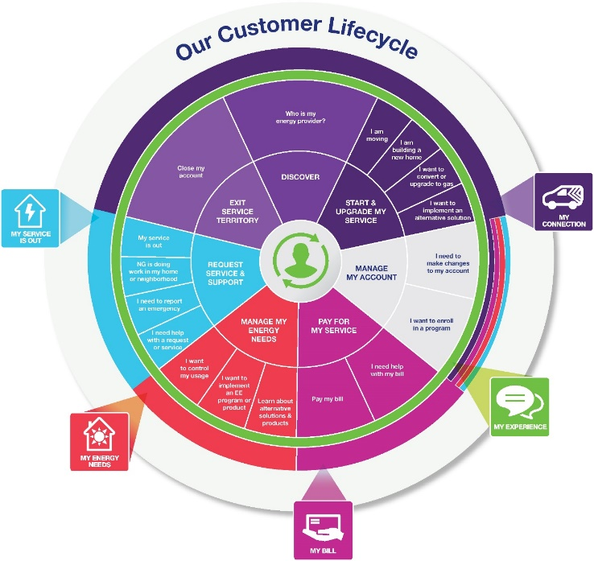
Marketing & Communications – frameworks, boundaries, business partners?
For Discussion
Customer Journey
Product/Service Lifecycle
Customer Experience Products
Channel Planning & Improvement
Social Engagement
Customer Operations & Business Services: Preferences, Credit & Collections
Customer Performance & Assurance
Product Groups: New Connections, EE, EV, DG, DR, Customer Experience Products
Prospective Business Partners
Notes:
Don’t do it just because there is a deadline.

Slide 5


Information Flow Analysis – where does Marketing & Communications play?
Products/
Services
Contact /
Customer
Profile /
Preferences
Lead /
Opportunity
Location
(Premise)
Case
(e.g. Application/
Work Order
Complaint)
Customer
/ Account
Asset
(e.g. Meter /
Product
Thermostat)
Usage
(Meter
Reading)
Bill /
Payment
GL
Account
Data Domain
Market / Sales
Market / Sales
Market / Sales
Service
Service
3
Service
Asset
Asset
Bill/Pay
Finance
Need to align with Electric and Gas Ops Flows
Need to align with Electric and Gas Ops Flows
CSS Transaction Web
1
CRIS Transaction Web
Need to end to end process for Lead/Opportunity for all products
Application Portal (DG/Electric)
Need to add metering systems for input into CIS systems
Marketplaces (EE/EV Products)
2a
Need details Marketplace - Reimbursements for LC&I, Small Business and Trade Partners via DSM. Manual and Automated Flows
Questline / MC (Marketing Comm)
2b
Kubra (Outage Comms)
email
Right Now
CRM Sales (Grid Force)
In-Demand (DSM/EE Program Mgt.)
Applications
CRIS (Gas –NYC,MA)
CSS (Gas, Elec, DG)–UNY,MA,RI,LI)
CRM Service (GBE-RI)
MITS (CSS) / SPIPE / DIS (CRIS)
GIS
Maximo / MDSI
Need to find more details about CRIS GIS Feed
Storms / Mwork / MDSI (LI)
OMS (Outage)
SAP ECC6
CEMP 3rd Party (Uplight / O-Power)
4
CIAP
Customer
Data Platforms
ADA
CDI
CCAE
CSS (Revenue) Data Warehouse
CSQ / Trends
Automated API
Automated Replication
Single data master agreed
No Explicit Master / Implied
Data mastered in multiple applications
(This includes across all Jurisdictions)
DB Link
Manual replication
Notes:
Don’t do it just because there is a deadline.

Slide 6
Master Data Flows
Marketing & Communications Perspectives
CIAP Dimensions & Structure – sufficient to support Marketing & Communications function? Conflicting dimensions & Structures – what internal conflicts does CIAP have?
Other Key Sources - what is missing?

Slide 7
Transactional Flows – Marketing & Communications responsibility?
Live Discussion
Inbound Data – what transactional-level or customer/household data does Marketing & Communications responsible for procuring, importing, associating:
?
Marketing Analytics & Communication/Campaign Data (Internal Use) – what customer/household/account data is moved to/from CIAP to support Marketing & Communications activities:
?
Outbound Transactional Data – what customer/household data is forwarded to third-parties as part of marketing execution initiatives? Who creates/extracts/manages these flows?
?

Slide 8
Notes
Live Discussion
?
Notes:
Don’t do it just because there is a deadline.

